Slide 1
www.TheRestorationMovement.com

Slide 2
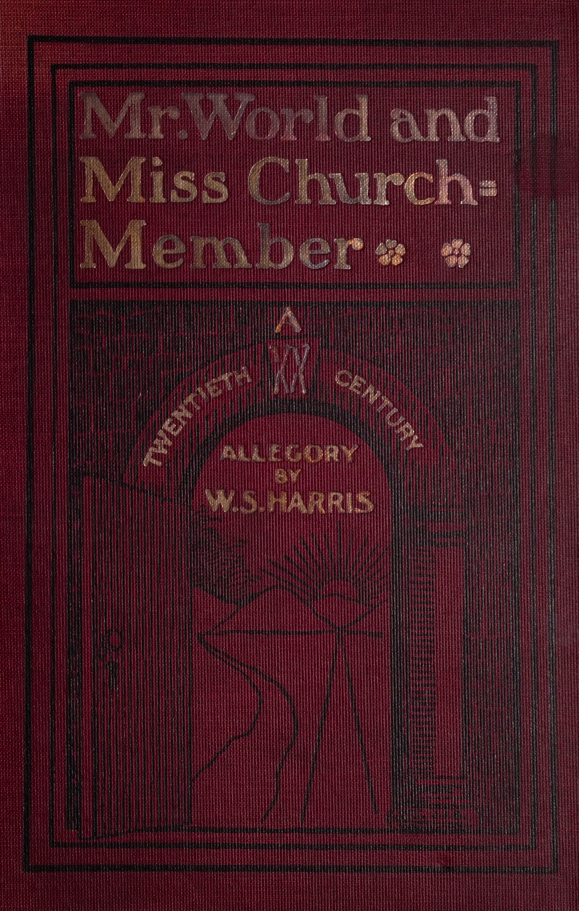
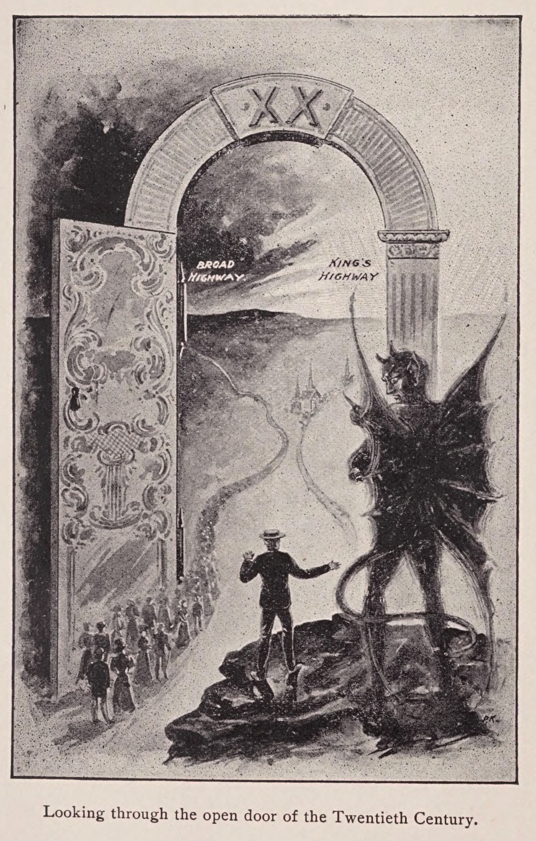
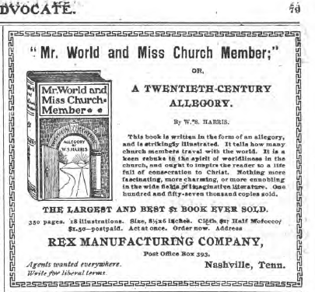
Overview Of
The 20th
Century
1,120,000 members

Slide 3
1906 US Religious Census

Slide 4
Further Division Among Disciples
March, 1917 Major Controversy In The College Of The Bible Exists Over The Subject Of Higher Criticism, Leading To A Major Split Among Christians, Enter: The Disciples Of Christ
By 1927, further division between Disciples of Christ and Christian Churches (Independent) exist.
1968, Restructure among Disciples takes place, that organizes them into a full denomination - headquarters are in Indianapolis, Indiana.
Notes:
▪ Two Resolutions at the 1987 General Assembly: 1st – Condemned Homosexuality; 2nd – Said Salvation is Only in the Name of Jesus. ▪ Both Resolutions Failed!
As of 2009 there were about 800,000 Disciples, and membership is in rapid decline.

Slide 5
The Christian Church
1927 – Start of the North American Christian Convention identified a “conservative” group of Disciples
Maintain affiliation with Disciple of Christ, but are moving away from them theologically
1950s some of the
conservative churches were
sued by the more liberal
Disciple to try to get the
buildings and other property
Southeast Christian Church, Louisville, KY
Notes:
▪ Two Resolutions at the 1987 General Assembly: 1st – Condemned Homosexuality; 2nd – Said Salvation is Only in the Name of Jesus. ▪ Both Resolutions Failed!
As of 2009 there were about 800,000 Disciples, and membership is in rapid decline.

Slide 6
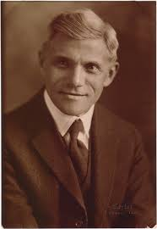
Premillennialism
Robert H. Boll
1875-1956
Notes:
May 1956, Word and Work – Sam Harris, April 14, 1895, baptized near Smyrna, TN.
Other Pre-mil preachers, like Barton W. Stone, James A Harding, Dr. T W Brents, (dispensational,
Post Millennial – Campbell thought things will get better and better and the millennium will set in, and then the Lord will come again.

Slide 7
A Time Of Growth
1936 – Census records showed churches of Christ, non-instrumental at 309,551 members with 3,815 congregations.
1946 - M. Norvel Young had been researching numbers and suggested there were 682,172 members with more than 10,000 congregations.
Relative Rest Among the Churches During The War Years.

Slide 8
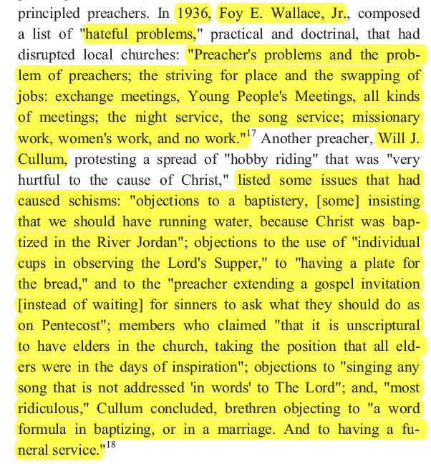
Controversy In 1930s
-The Churches of Christ in the Twentieth Century, Homer Hailey’s Personal Journey of Faith, by David Edwin Harrell, Jr., p.45

Slide 9
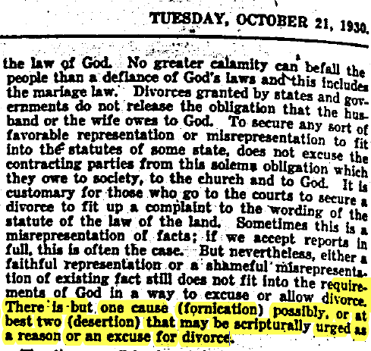
Divorce/
Remarriage Issue - 1930
General Consensus that the Scriptures only give one
reason for divorce and remarriage – fornication! Matthew 19
- G.H.P. Showalter, Editorial, “The Divorce Evil,”
Firm Foundation, October 21, 1930

Slide 10
The World At War
4.5.1917-11.11.1918 – US involved in the Great War
12.8.1941-9.2.1945 – US involved in WWII
Initially the GA ran articles encouraging conscientious objectors. But by August, it had reversed its push due to government intimidation (The Espionage Act of 1917).
Many preachers files as CO’s, and some were held in CO camps.
Brethren were heavily divided over the issue. GA was more CO, while FF was for taking up arms.
Notes:
4.5.1917-11.11.1918 – US involved in the Great War
12.8.1941-9.2.1945 – US involved in WWII
Initially the GA ran articles encouraging conscientious objectors. But by August, it had reversed its push due to government intimidation (The Espionage Act of 1917).
Many preachers files as CO’s, and some were held in CO camps.
Brethren were heavily divided over the issue. GA was more CO, while FF was for taking up arms.

Slide 11
Post War Evangelism
At the conclusion of WWII, evangelism took on a new determinate movement in the brotherhood. Otis Gatewood, Batsell Barrett Baxter and others led missions to war-torn Europe
People were more evangelistic among their neighbors
Churches of Christ was quickly becoming the fastest growing “denomination” in America.
Questions of how congregations can cooperate to support missions began to be discussed in brotherhood papers.

Slide 12
Anti/Ultra Conservative Movement
Located Preacher – in the 1920s
Sunday School Material controversy – 1930s
Christian College – support from the church treasury/institutions doing the work of the church to train, etc. – early at 1930s
Institutionalism – as early as 1930s it was being questioned how to support it.
Herald Of Truth – national radio, later television, broadcast received a divided interest in the early 1950s
Orphanage Support in 1950’s - 1960s

Slide 13
Unity Meetings
Efforts on local and national level to reunite with Christian Churches/Disciples of Christ
1937 meeting in Cincinnati – Claud F. Witty & James Deforest Murch
1939 meeting in Indianapolis – H. Leo Boles killed the meeting with a passionate message on how unity can be restored by honoring Biblical Authority
Unity meetings continued into the 70s, 80s and 90s, but never accomplished the intended goals.
Also meetings with Non-Institutional brethren, like The Arlington Meeting, 1968, - 2 more in the 70s

Slide 14
Other Controversies in the Late 20th Century
1980s, 90’s – The New Hermeneutic Movement – reinterpreting the Scriptures
1970s,1980s – Crossroads/Boston Movement – reinterpreting Evangelism
1970s – Marriage, Divorce & Remarriage
1980s, 90’s – Apathy, and decline in Evangelism, churches are reducing in numbers with every passing year.

